Slide 1
Imaging
Draft Design

Slide 2
Startup
New project from Camera(WIA Driver)
New project from Scanner(TWAIN Driver)
New project from files
New empty project
Open last working Project
* Continue upload unfinished job

Slide 3
View
Thumbnail View Panel
Toolbar
Preview Image window
Image Tool Panel
Message Pannel

Slide 4
File
Upload Images to Server
Export as image files
Import image files
Change image filenames(sequential)
Settings
Exit

Slide 5
Edit(optional)
Selection
Erase
Copy & Paste
Brush draw
Shape
Annotation(line, box, text, image)

Slide 6
Image Feature
Delete/Move/Insert image
Crop
Rotate
Resize
Monochrome(dithering, grayscale)
Color Balance, HLS Control, Bright & Contrast, Color Level, Color curve, Reverse Color.

Slide 7
Toolbar
New, Upload, Export, Import
Thumbnail On/Off
Image Tool On/Off
Erase/Copy/Paste
Screen zoom
Insert(folder, image, scan), Delete, Move pages
Crop, Rotate, Resize
Monochrome
Image Adjust

Slide 8
Thumbnail panel
Tree style(2 depth, folder and image)
Folder can be opened/closed
Scroll with mouse wheel
Multiple selection

Slide 9
Preview window
Zoom with mouse wheel
Scroll with mouse drag

Slide 10
Property panel
Normal mode : show image info & Meta info
Crop mode : coordinate and apply
Rotate mode : direction, angle and apply
Image edit mode : selection, annotation

Slide 11
Output panel
Show events
Show error messages when upload

Slide 12
New Project
New Imaging |  |  |  |  | _ □ Χ
◎New Project from Camera ◎New Project from Scanner ◎New Project from local files ◎New empty project ◎Open last project
 | OK | Cancel
C:\문서\내 프로젝트1
C:\문서\내 프로젝트2
…

Slide 13
Main Screen
Imaging |  |  |  |  | _ □ Χ
Toolbar(file, view, edit, image)
Thumbnail |  |  |  | Image Tool & Options
 |  | Preview image
<Progress>
Upload files (3/5) 3분 남음

Slide 14
Crop
Imaging |  |  |  |  | _ □ Χ
Toolbar(file, view, edit, image)
Thumbnail |  |  |  | Crop Image▼
 |  |  |  | Left Top Right Bottom
 |  | Preview image
 |  |  |  | √All images
 |  |  |  | Apply

Slide 15
Rotate
Imaging |  |  |  |  | _ □ Χ
Toolbar(file, view, edit, image)
Thumbnail |  |  |  | Rotate Image ▼
 |  |  |  | 90 Clockwise 90 CC 180 Flip Horizontal
 |  | Preview image
 |  |  |  | √All images
 |  |  |  | Apply

Slide 16
Color Balance
Imaging |  |  |  |  | _ □ Χ
Toolbar(file, view, edit, image)
Thumbnail |  |  |  | Color Balance ▼
 |  |  |  | Red Green Blue
 |  | Preview image
 |  |  |  | √All images
 |  |  |  | Apply

Slide 17
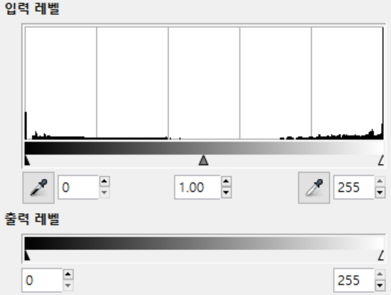
Color Level
Imaging |  |  |  |  | _ □ Χ
Toolbar(file, view, edit, image)
Thumbnail |  |  |  | Color Level ▼
 |  | Preview image
 |  |  |  | √All images
 |  |  |  | Apply

Slide 18
HLS Control
Imaging |  |  |  |  | _ □ Χ
Toolbar(file, view, edit, image)
Thumbnail |  |  |  | HLS Control ▼
 |  |  |  | Hue Lightness Saturation
 |  | Preview image
 |  |  |  | √All images
 |  |  |  | Apply

